Slide 1


Slide 2
Propositional attitudes …
cause actions
resemble “intervening variables” linking environment to behaviour
have contents which may be true or false
have contents which may refer to non-existent entities
are involved in uncodifiably complex causal interactions
have contents which are individuated by senses, not only by referents
are associated with normative requirements
are indviduated in terms of their interlocking roles in causal and normative explanations of thought and action
…

Slide 3
Propositional attitudes …
cause actions
resemble “intervening variables” linking environment to behaviour
have contents which may be true or false
have contents which may refer to non-existent entities
are involved in uncodifiably complex causal interactions
have contents which are individuated by senses, not only by referents
are associated with normative requirements
are indviduated in terms of their interlocking roles in causal and normative explanations of thought and action
…
Notes:
Metarep conjecture

Slide 4
Propositional attitudes …
cause actions
resemble “intervening variables” linking environment to behaviour
have contents which may be true or false
have contents which may refer to non-existent entities
are involved in uncodifiably complex causal interactions
have contents which are individuated by senses, not only by referents
are associated with normative requirements
are indviduated in terms of their interlocking roles in causal and normative explanations of thought and action
…

Slide 5
Propositional attitudes …
cause actions
resemble “intervening variables” linking environment to behaviour
have contents which may be true or false
have contents which may refer to non-existent entities
are involved in uncodifiably complex causal interactions
have contents which are individuated by senses, not only by referents
are associated with normative requirements
are indviduated in terms of their interlocking roles in causal and normative explanations of thought and action
…

Slide 6
Propositional attitudes …
cause actions
resemble “intervening variables” linking environment to behaviour
have contents which may be true or false
have contents which may refer to non-existent entities
are involved in uncodifiably complex causal interactions
have contents which are individuated by senses, not only by referents
are associated with normative requirements
are indviduated in terms of their interlocking roles in causal and normative explanations of thought and action
…

Slide 7
signature limits

Slide 8
1. Charly is Samantha
2. Mitch believes that Charly is in Baltimore
3. Mitch believes that Samantha is in Baltimore
(1) & (2) ⇒ (3)

Slide 9
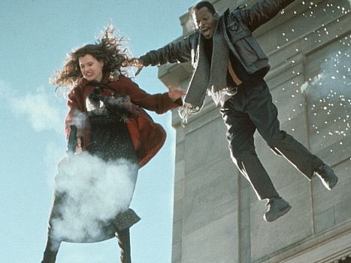
1. Charly is Samantha
2. Mitch believes that Charly is in Baltimore
3. Mitch believes that Samantha is in Baltimore
(1) & (2) ⇒ (3)

Slide 10
1. Charly is Samantha
2. Mitch believes that Charly is in Baltimore
3. Mitch believes that Samantha is in Baltimore
(1) & (2) ⇒ (3)
4. Mitch registers <Charly, Baltimore>
5. Mitch registers <Samantha, Baltimore>
(1) & (4) ⇒ (5)

Slide 11
False belief about location
False belief about identity
Subjects represent registration
Subjects represent beliefs
pass
fail
pass
pass

Slide 12
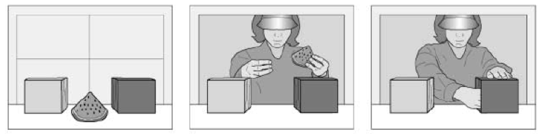
Notes:
Onishi and Baillargeon control condition

Slide 13
Yellow
Green
Notes:
Onishi and Baillargeon control condition

Slide 14
Yellow
Green
Notes:
Onishi and Baillargeon control condition

Slide 15
Yellow
Green
Notes:
Onishi and Baillargeon control condition

Slide 16
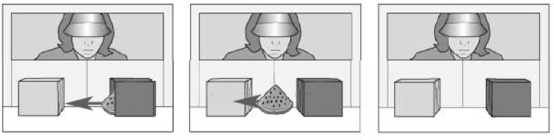
Yellow
Green
Notes:
Onishi and Baillargeon control condition

Slide 17
Yellow
Green
Notes:
Onishi and Baillargeon control condition

Slide 18
Yellow
Green
Notes:
Onishi and Baillargeon control condition

Slide 19
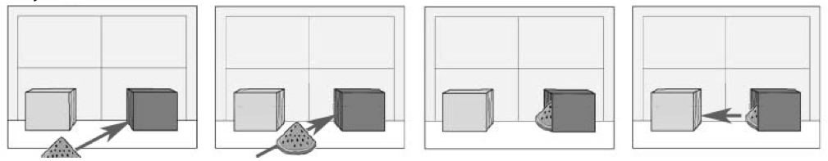
Notes:
Add in the decoy object, the identical twin of the first watermelon slice

Slide 20

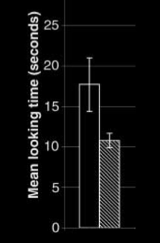
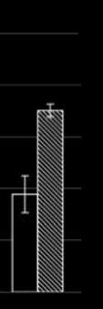
registration
belief
Notes:
Add in the decoy object, the identical twin of the first watermelon slice

Slide 21
False belief about location
False belief about identity
Subjects represent registration
Subjects represent beliefs
pass
fail
pass
pass

Slide 22


Slide 23
number

Slide 24
signature limits

Slide 25
1. we can distinguish representations of representations (metarepresentations) from representations of other things
2. metarepresentation requires conceptual sophistication
3. metarepresentation is cognitively demanding in the sense that it consumes executive function, working memory and attention
4. we can distinguish mental from non-mental states (e.g. a belief is mental, shape is not)
5. all mental states characteristically involve representation
6. to represent a mental state requires metarepresentation
7. representing mental states is conceptually and cognitively demanding
8. Propositions (2), (3) and (6) explain why (7)

Slide 26
"We … use the acronym ToM, to refer to any cognitive system, whether theorylike or not, that predicts or explains the behaviour of another agent by postulating that unobservable inner states particular to the cognitive perspective of that agent causally modulate that agent’s behaviour."
(Penn & Povinelli 2007: 732)

Slide 27
"We … use the acronym ToM, to refer to any cognitive system, whether theorylike or not, that predicts or explains the behaviour of another agent by postulating that unobservable inner states particular to the cognitive perspective of that agent causally modulate that agent’s behaviour."
(Penn & Povinelli 2007: 732)

Slide 28
X preens me
X sings
X likes me
preen X

Slide 29
X preens me
X sings
X likes me
preen X

Slide 30
X preens me
X sings
X likes me
preen X

Slide 31



“chimpanzees understand … intentions … perception and knowledge … Moreover, they understand how these psychological states work together to produce intentional action”
(Call & Tomasello 2008:191)
“our fundamental understanding of […] knowledge is that it is something whose possession by an individual can properly be explained by reference to […] ways of coming to know.”
(Cassam “What is Knowledge?”, forthcoming)

Slide 32
Isn’t the puzzle just about false belief (not knowledge, perception)?

Slide 33
“chimpanzees understand … intentions … perception and knowledge … Moreover, they understand how these psychological states work together to produce intentional action”
(Call & Tomasello 2008:191)

Slide 34
“chimpanzees understand … intentions … perception and knowledge … Moreover, they understand how these psychological states work together to produce intentional action”
(Call & Tomasello 2008:191)

Slide 35
“chimpanzees understand … intentions … perception and knowledge … Moreover, they understand how these psychological states work together to produce intentional action”
(Call & Tomasello 2008:191)
“we understand what knowledge is by understanding how we get it or how it comes to be.”
(Casssam 2008)

Slide 36
“chimpanzees understand … intentions … perception and knowledge … Moreover, they understand how these psychological states work together to produce intentional action”
(Call & Tomasello 2008:191)
“we understand what knowledge is by understanding how we get it or how it comes to be.”
(Casssam 2008)
Tim knows that Luisa scored because he saw her do it

